Slide 1
Tutorial: Scalable Graph Neural Networks with Deep Graph Library
George Karypis, Zheng Zhang, Minjie Wang, Quan Gan, and Da Zheng

Slide 2
Agenda
9:00-10:00 Overview of graph neural networks
10:00-10:30 Overview of deep graph library (DGL)
10:30-11:00 Virtual coffee break
11:00-12:00 (Hands-on) GNN models for basic graph tasks
12:00-13:00 Virtual lunch break
13:00-14:30 (Hands-on) GNN training on large graphs
14:30-16:00 (Hands-on) Distributed GNN training

Slide 3
Overview of Graph Neural Networks
George Karypis
Senior Principal Scientist, AWS Deep Learning Science, Palo Alto, CA, USA, gkarypis@amazon.com Professor, Department of Computer Science & Engineering, University of Minnesota, Minneapolis, MN, USA, karypis@umn.edu, (on leave)

Slide 4
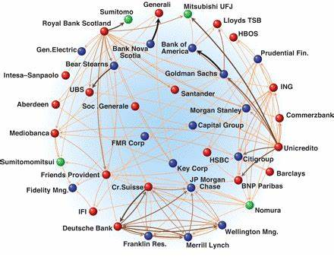
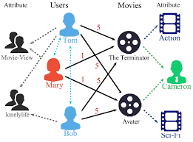
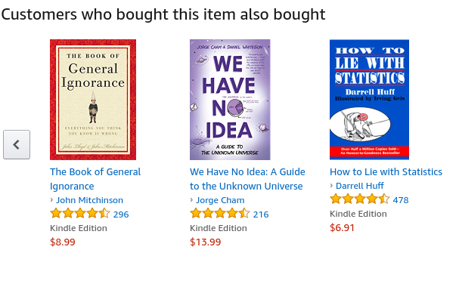
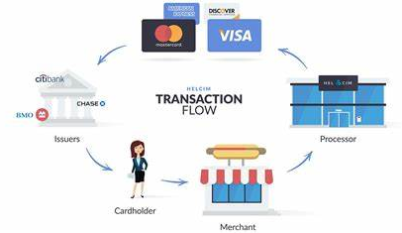
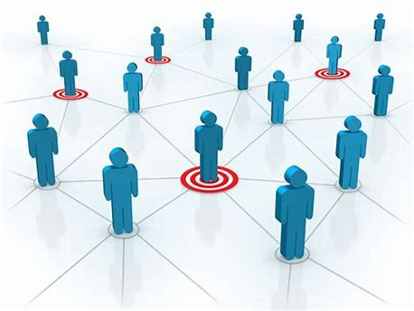
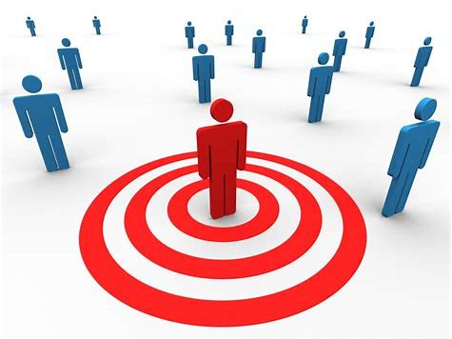
Fraud & Abuse
Recommendations
Detect malicious accounts, fraudulent financial transactions, fake reviews, fraudulent insurance claims, …
Products, media, articles, experiences, jobs, courses, spouses, …
Financial transactions network
Collaborative knowledge graph
Marketing
Who should get a discount? Who are the influencers? Who are the risk of churning?
Social network
Notes:
To motivate the use of graph neural networks, I will like us to consider three applications.
Fraud & abuse
Recommendations
Marketing
[Before showing graphs]
What is common in all these applications is that they use graphs to represent their underling data.
For example, describe each graph.
Now, what is even more interesting is that I can use these graphs to solve the underling problems by using ML approaches based on graph learning!
e.g., find fraudulent financial transactions, decide what to recommend to Tom, and find the most influential people to target

Slide 5
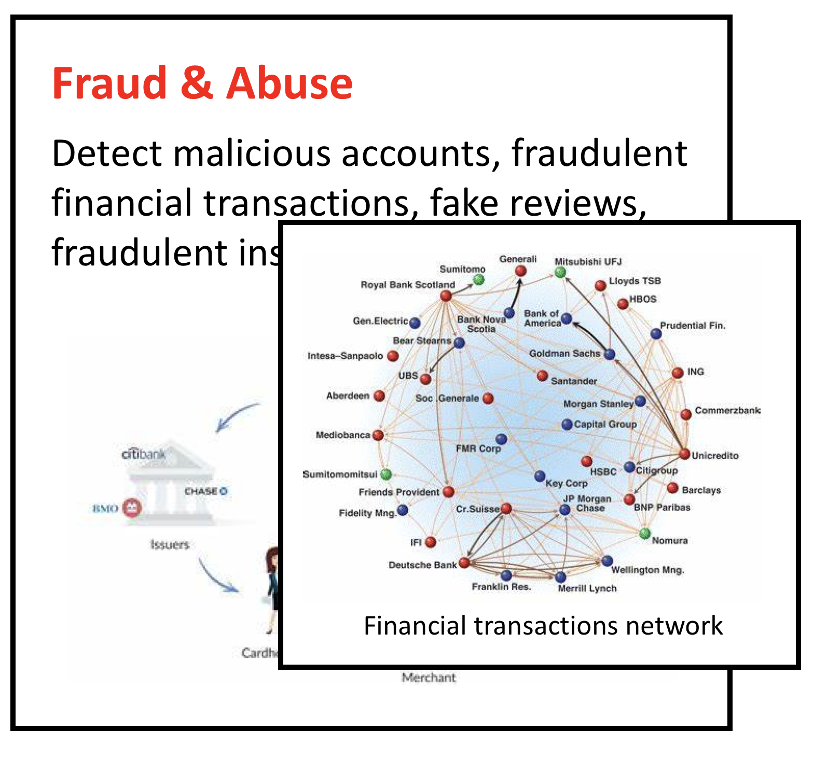
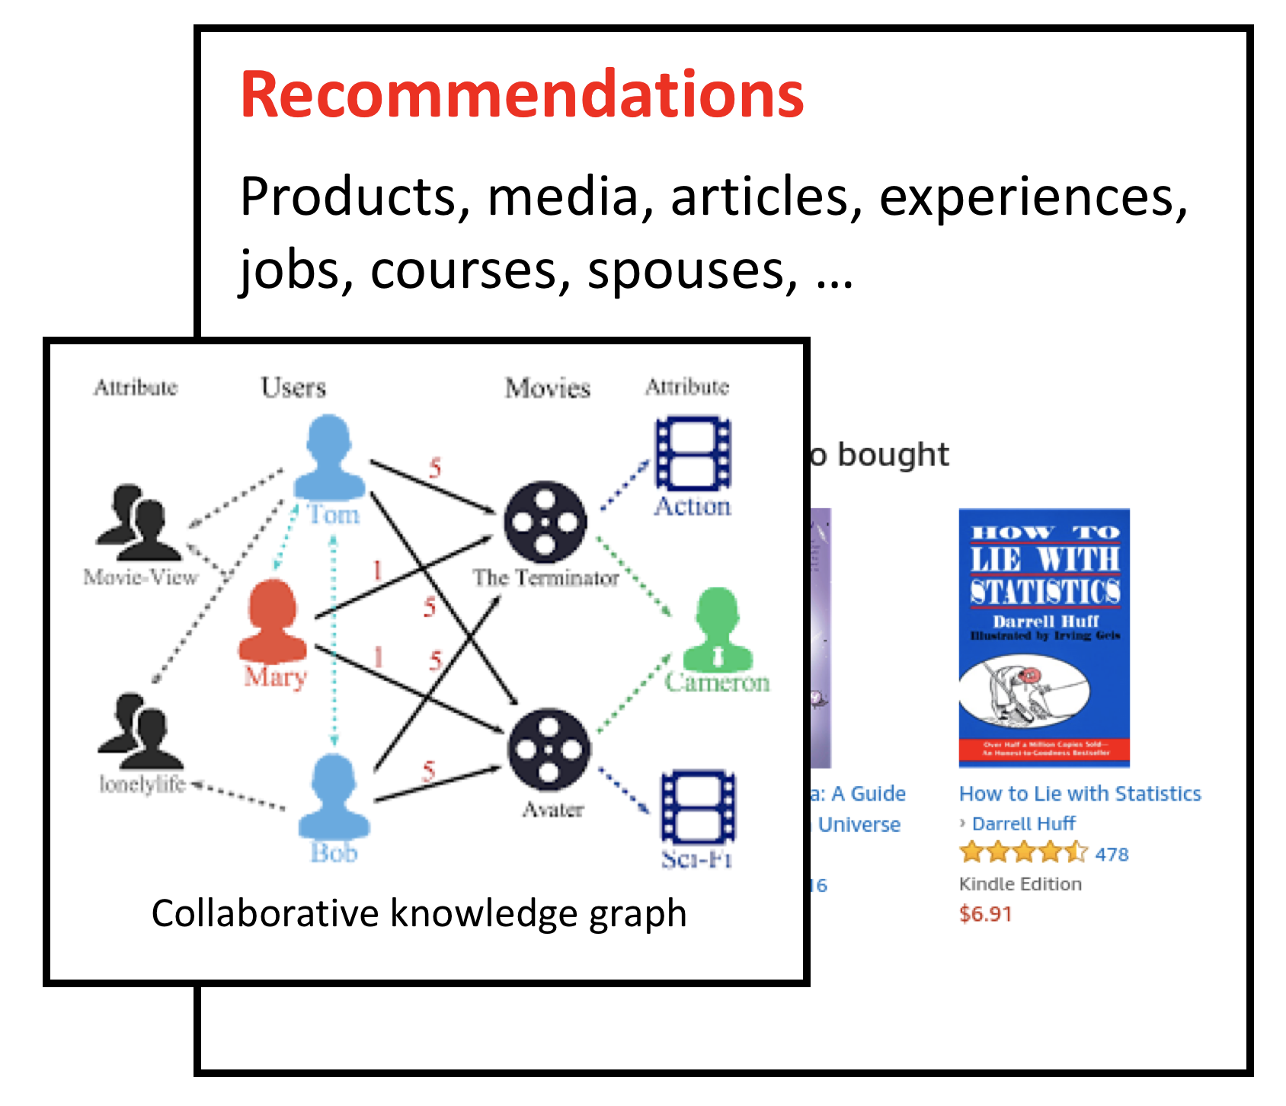
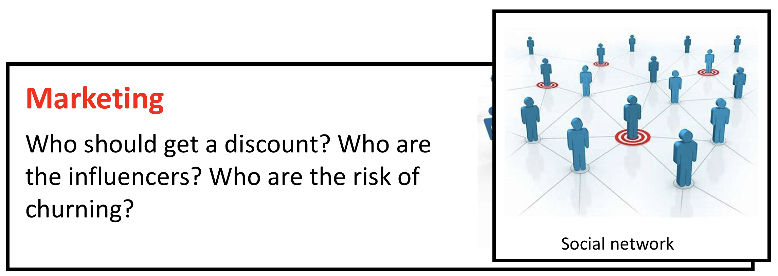
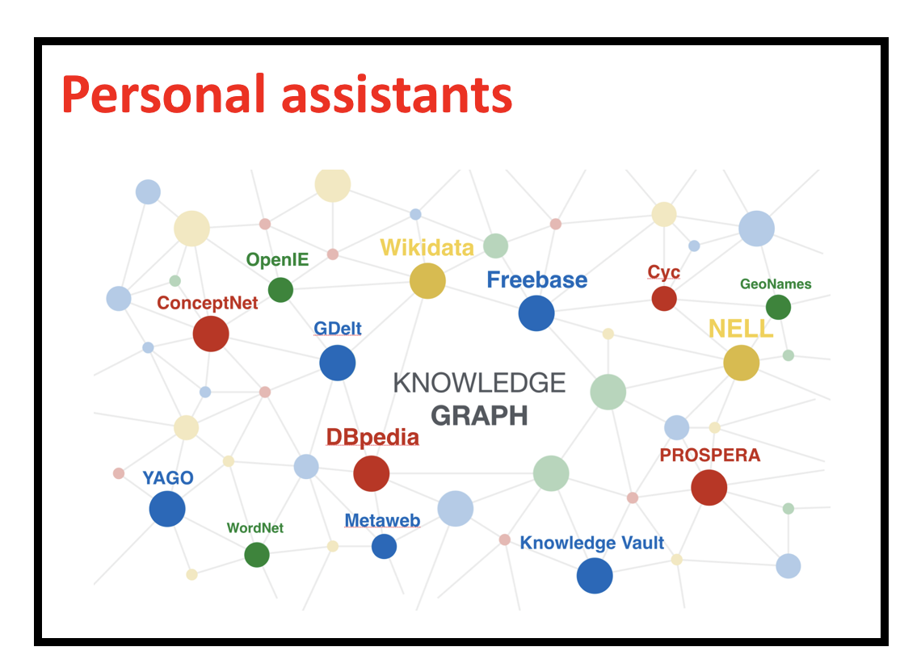
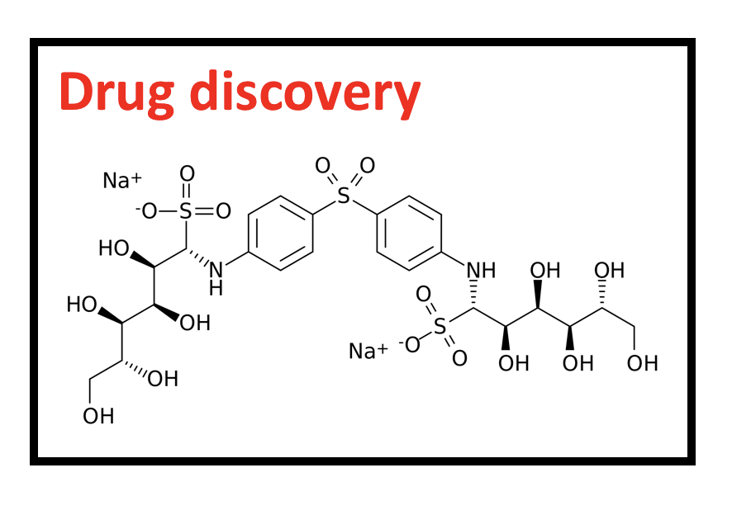
Tasks in graph learning
Node classification
Detect malicious accounts
Target right customers
Link prediction
Recommendations
Predict missing relations in a knowledge graph
Graph classification
Predict the property of a chemical compound

Slide 6
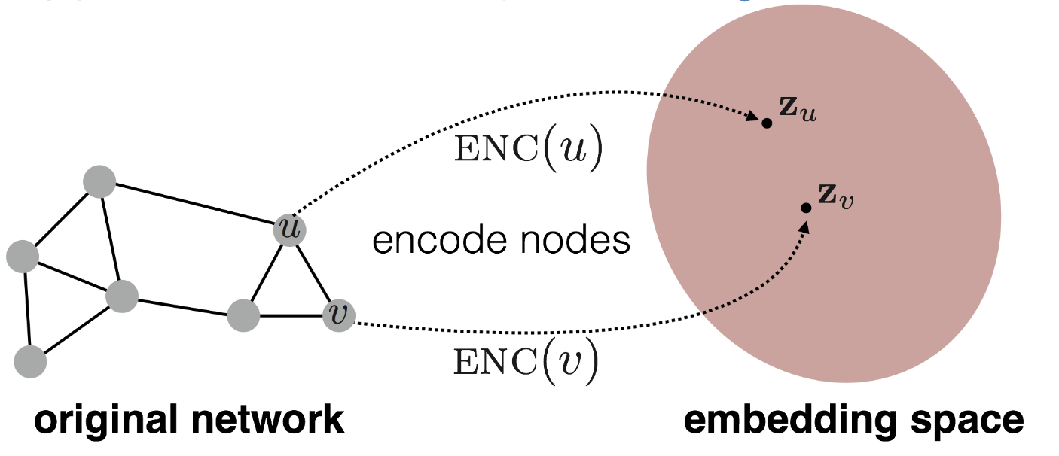
Graph learning and node embeddings
Embed nodes to a low-dimension space so that these embeddings capture the essential task-specific information and use them to train off-the-self classifiers.
For example, node similarities in the embedding space approximates the similarities in the original graph.
Representation Learning on Networks, snap.stanford.edu/proj/embeddings-www, WWW 2018
Notes:
A common way to solve the various graph learning problems is to …

Slide 7
Traditional node embedding approaches
Generate embeddings by manual feature engineering
Requires domain expertise, involves considerable manual fine-tuning, time consuming, does not scale, …
Automatically generate embeddings using unsupervised dimensionality reduction approaches
Singular value decomposition, tensor decomposition, co-factorization, deep walks, etc.
Cannot effectively combine rich attributes with network structure.
Employ mostly (multi-)liner models.
Do not allow for end-to-end learning.

Slide 8
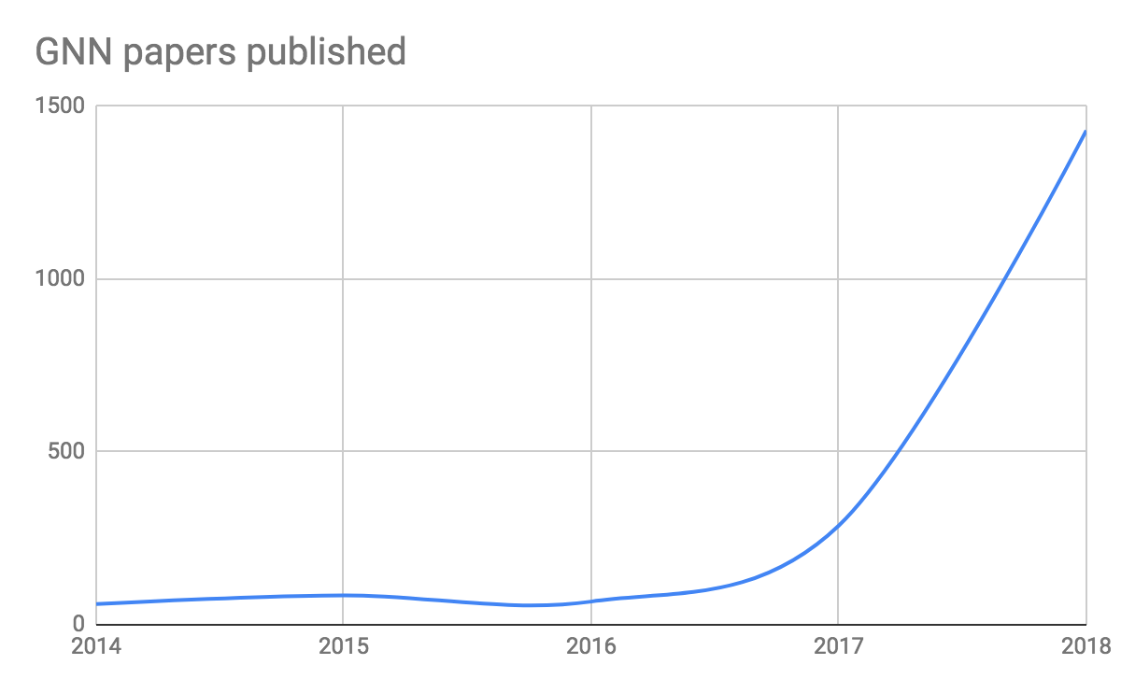
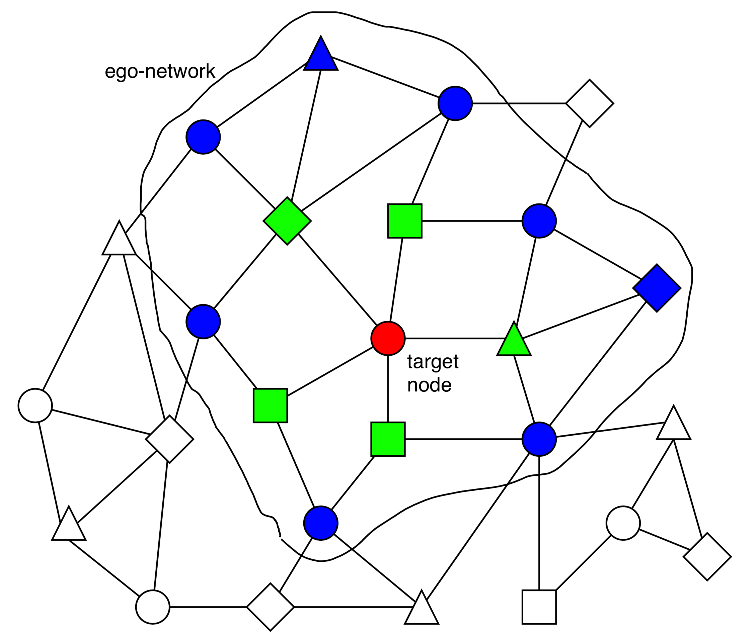
Can we do better?
They are becoming extremely popular.
Graph Neural Network (GNN)
A family of (deep) neural networks that learn node, edge, and graph embeddings.
How do GNNs work?
An ego-network around each node is used to learn an embedding that captures task-specific information.
The embeddings use both the structure of the graph and the features of the nodes and edges.
The embeddings are learned in an end-to-end fashion; thus, the predictions are a function of the target node’s ego-network.

Slide 9
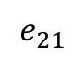
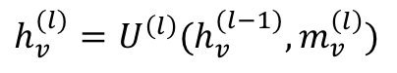
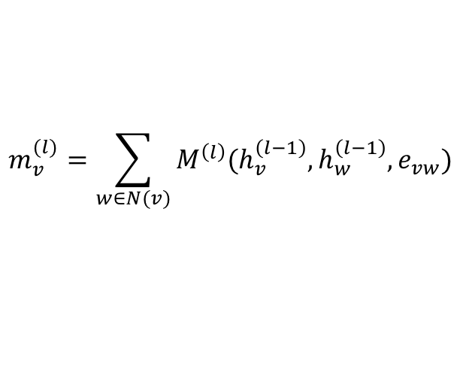
A general graph neural network formalism
Graph neural networks are based on message-passing
Reduce/Aggregate
h₅
Message
h₂
v₅
$$m_{v}^{(l)}=\sum_{w∈N(v)}{M^{\left(l\right)}(h_{v}^{\left(l−1\right)}, h_{w}^{\left(l−1\right)}, e_{vw})}$$
v₂
$$e_{21}$$
v₁
h₁
$$h_{v}^{(l)}=U^{\left(l\right)}(h_{v}^{(l−1)}, m_{v}^{\left(l\right)})$$
Update
v₃
v₄
h₄
h₃
Neural Message Passing for Quantum Chemistry
Notes:
Though there is a number of prototypical graph neural network formalisms, probably the most common one is the one that is based on the message passing model.
The idea is that nodes send messages to their adjacent nodes, then each node aggregates all the messages that it receives from its incidents nodes, and uses those messages to update its representation/embedding.
The set of operations involving message passing, aggregation, and update correspond to a layer of the GNN network.

Slide 10
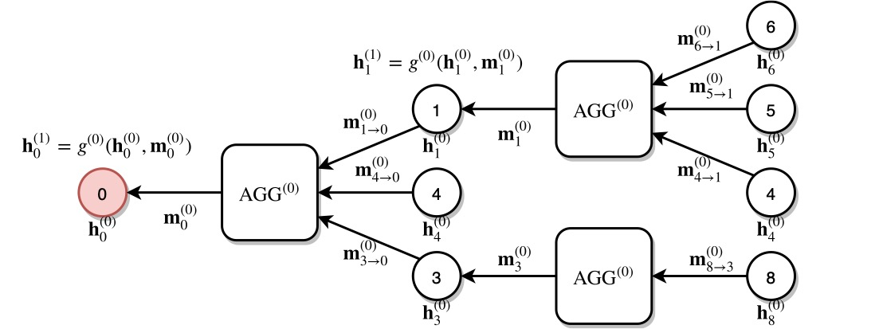
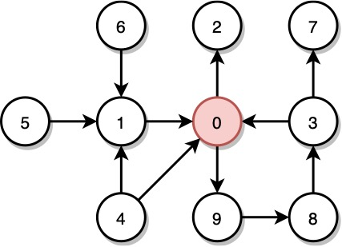
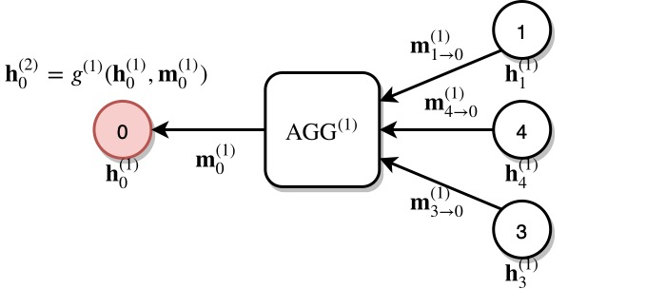
A multi-layer GNN
Multiple GNN layers can be stacked together.
1st layer
2nd layer
Notes:
Such rounds of message passing, aggregations, and updates can be done multiple types.
By having multiple layers, the representation of a node includes information from nodes that are topological further away==> from a deeper ego-network.

Slide 11
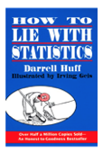
Why are graph neural networks better?
GNNs compute node embeddings using both the structure of the graph and the features of the nodes and edges.
Name: xxx
Age: xxx
Sex: xxx
Title: How to lie with statistics
Author: Darrell Huff
Type: Kindle Edition
Price: $6.91
users
books

Slide 12
Why are graph neural networks better?
GNNs can integrate topologically distant information in a non-linear fashion.
1st layer
2nd layer

Slide 13
Why are graph neural networks better?
GNNs and the downstream classification/regression models can be trained in an end-to-end fashion.
Traditional method
Classifier
GNN
Classifier
Notes:
Instead of computing the embeddings in an unsupervised fashion (e.g., low-rank factorization), they can be jointly trained so that they optimize the downstream prediction task.

Slide 14
Why are graph neural networks better?
GNNs are naturally inductive because they learn the same neural networks on all the nodes and edges.
GNN
GNN
Notes:
GNNs learn functions that compute node embeddings from the features of the node’s ego-network.
When those features do not encode information about the identity of the node itself (e.g., no 1-hot encoding) but correspond to features describing attributes/characteristics
[Change to the next image]
This has many advantages
Train on a small subset of the data and apply it to other data
Compute embeddings for nodes that were not available during training

Slide 15
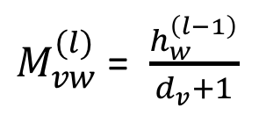
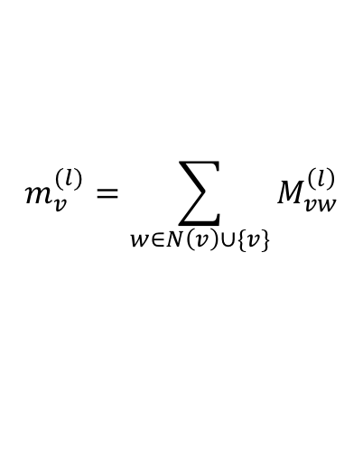
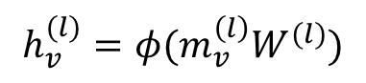
Example 1: Graph convolution network (GCN)
$M_{vw}^{(l)}$= $\frac{h_{w}^{\left(l−1\right)}}{d_{v}+1}$
$$m_{v}^{(l)}=\sum_{w∈N\left(v\right)∪\{v\}}{M_{vw}^{\left(l\right)}}$$
$$h_{v}^{(l)}=φ(m_{v}^{\left(l\right)}W^{(l)})$$

Slide 16
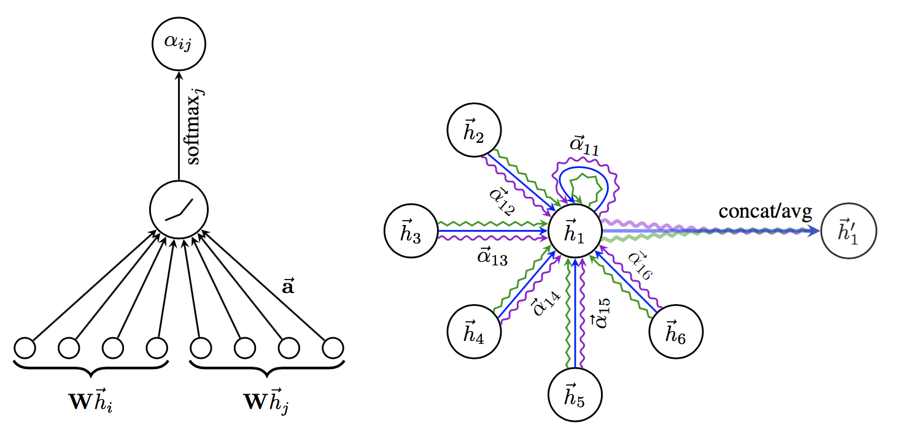
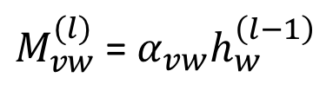
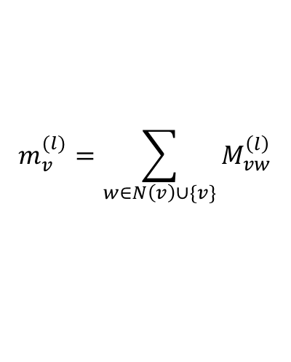
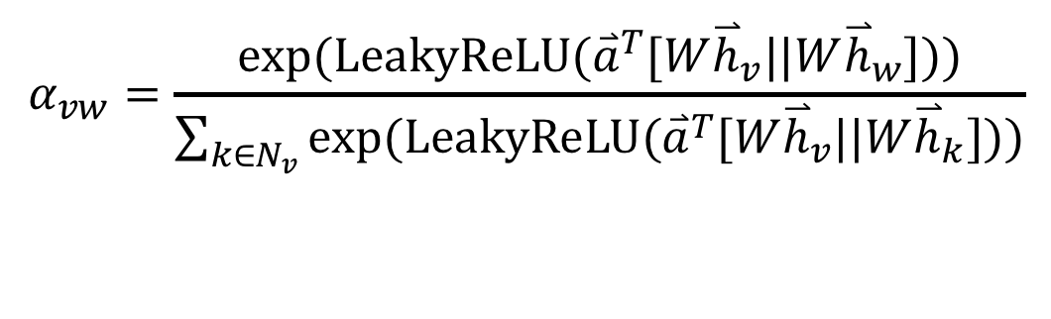
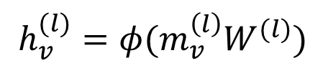
Example 2: Graph attention networks (GAT)
GAT provides weighted sum over the neighborhood—Enables to selectively integrate information.
$M_{vw}^{(l)}$= $α_{vw}h_{w}^{\left(l−1\right)}$
$$m_{v}^{(l)}=\sum_{w∈N\left(v\right)∪\{v\}}{M_{vw}^{\left(l\right)}}$$
$$h_{v}^{(l)}=φ(m_{v}^{\left(l\right)}W^{(l)})$$
$$α_{vw}=\frac{exp⁡(LeakyReLU({\overset{⃑}{a}}^{T}[W{\overset{⃑}{h}}_{v}||W{\overset{⃑}{h}}_{w}]))}{\sum_{k∈N_{v}}{exp⁡(LeakyReLU({\overset{⃑}{a}}^{T}[W{\overset{⃑}{h}}_{v}||W{\overset{⃑}{h}}_{k}]))}}$$

Slide 17
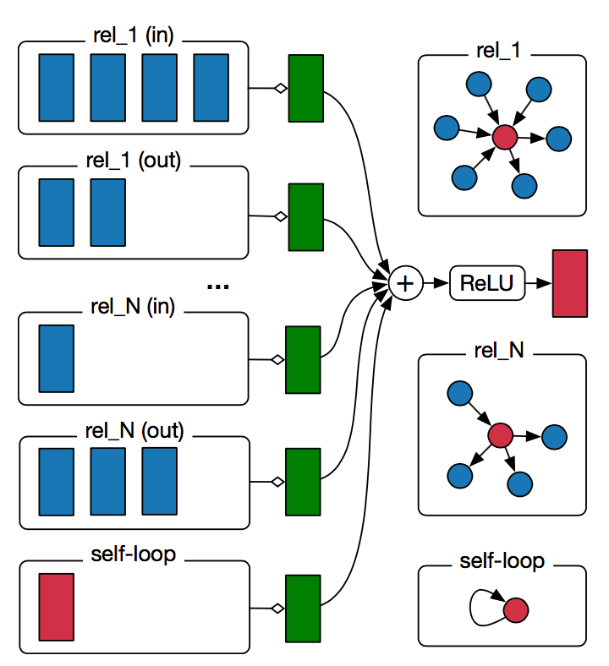
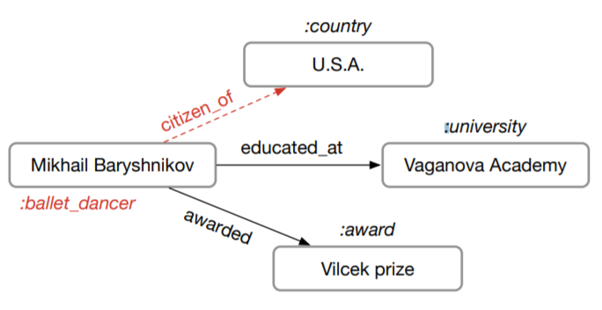
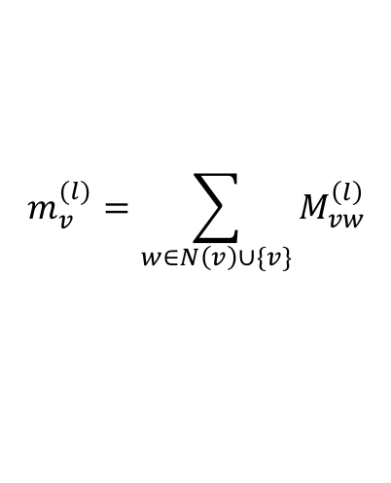
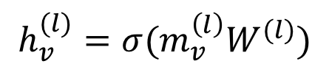
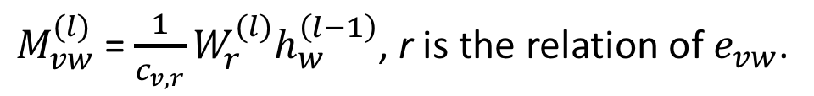
Example 3: Relational graph convolution networks (RGCN)
Handles graphs whose nodes are connected with different relations.
$M_{vw}^{(l)}$= $\frac{1}{c_{v,r}}W_{r}^{(l)}h_{w}^{\left(l−1\right)}$, r is the relation of $e_{vw}$.
$$m_{v}^{(l)}=\sum_{w∈N\left(v\right)∪\{v\}}{M_{vw}^{\left(l\right)}}$$
$$h_{v}^{(l)}=σ(m_{v}^{\left(l\right)}W^{(l)})$$
Notes:
In most real-world settings, the underlying graphs are heterogeneous
Define heterogeneous graphs
RGCN is a generalization of GCN to such graphs.

Slide 18
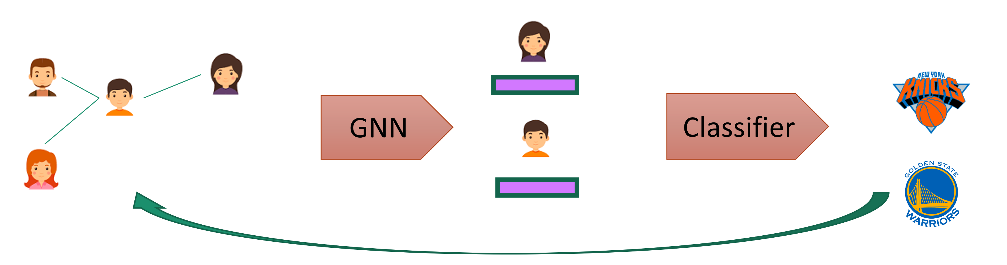
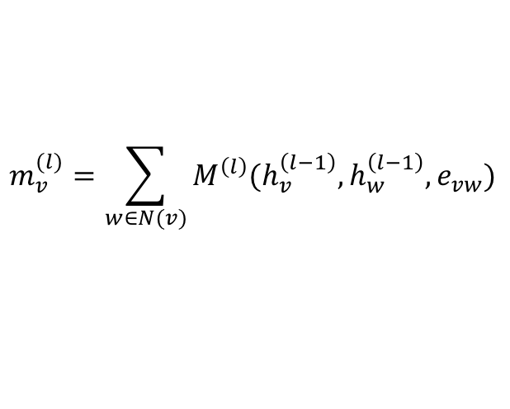
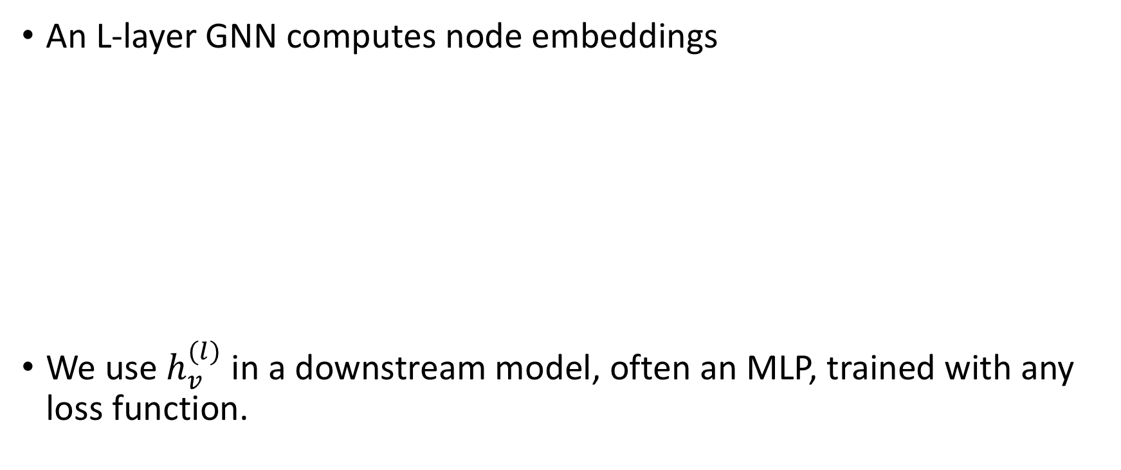
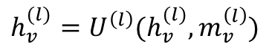
How to train an end-to-end GNN?
An L-layer GNN computes node embeddings
We use $h_{v}^{(l)}$ in a downstream model, often an MLP, trained with any loss function.
$$m_{v}^{(l)}=\sum_{w∈N(v)}{M^{\left(l\right)}(h_{v}^{\left(l−1\right)}, h_{w}^{\left(l−1\right)}, e_{vw})}$$
$$h_{v}^{(l)}=U^{\left(l\right)}(h_{v}^{(l)}, m_{v}^{\left(l\right)})$$

Slide 19
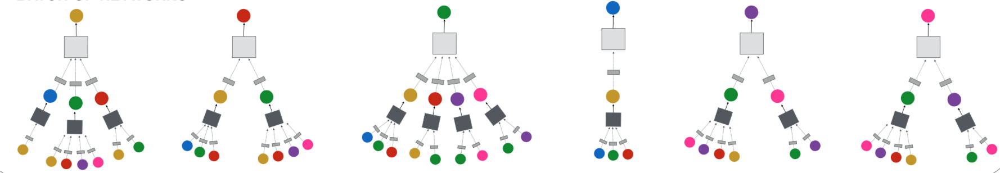
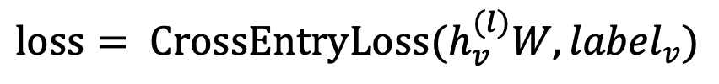
Node classification with GNN
Node classification is trained in the semi-supervised setting.
$$loss= {CrossEntryLoss(h}_{v}^{(l)}W, {label}_{v})$$
0
1
0
?
?
?
Notes:
Note that in many cases, the learning is done in a semi-supervise setting where not all the nodes in the graph has labels.
In such cases, it is only the labeled nodes that provide supervision by being the target nodes
However, all the nodes in the graph are used.

Slide 20
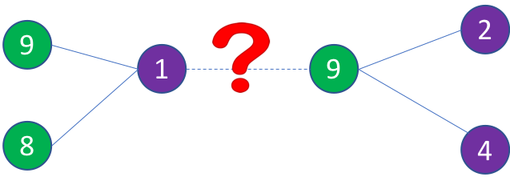
Link prediction with GNN
We train a link prediction model with connectivity of nodes as the training signal.
Positive edges are trained against a few negative edges
${loss= −log (σ⁡(h}_{v}^{T}h_{w}))−Q∙E_{u_{n}\sim P_{n}(v)}{log (σ⁡(−h}_{v}^{T}h_{u_{n}})$)
Positive edges
Negative edges
Graph convolution to
encode node embeddings
Graph convolution to
encode node embeddings
Notes:
To supervise link prediction, we create a loss function that rewards the pairs of vertices that are connected via edges (+ve examples) and penalizes the pair of vertices that are not (-ve examples).
In order to do that we usually define a function whose score should be high if a pair of vertices are connected via an edge and low otherwise.
The sigmoid of dot-product between the representations of the nodes is a common function.
The negative edges are often sampled randomly for the missing edges.

Slide 21
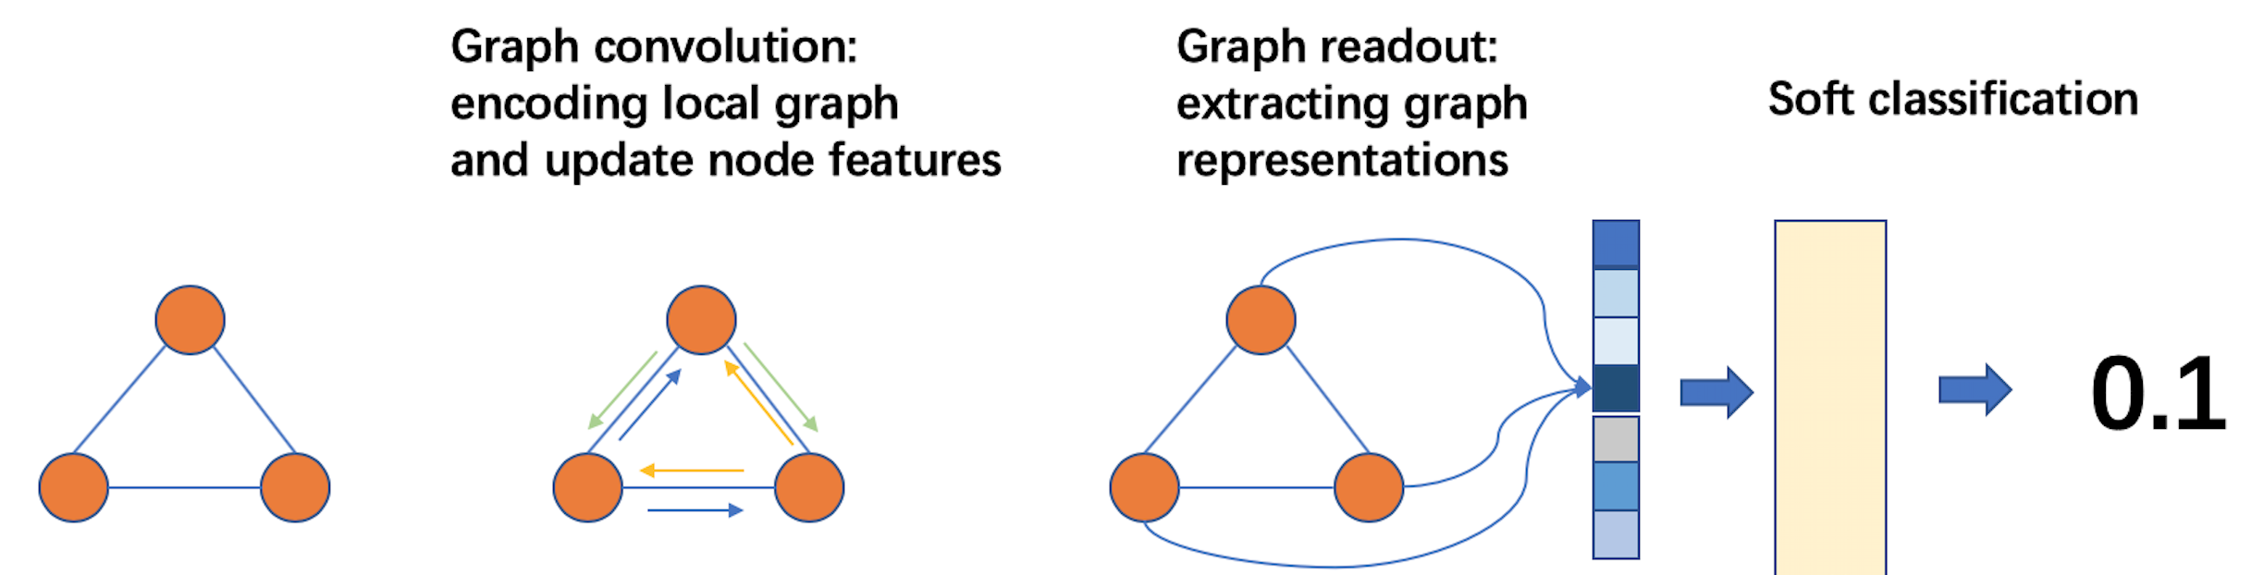
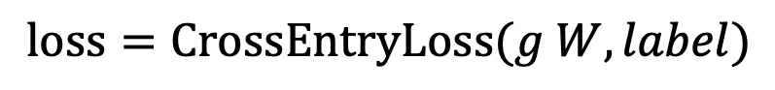
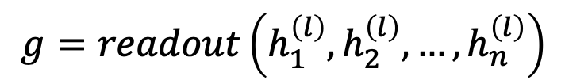
Graph classification
Graph readout to compute graph embeddings.
Train a graph classifier on the graph embedding.
$$g=readout\left(h_{1}^{\left(l\right)},h_{2}^{\left(l\right)}, …,h_{n}^{\left(l\right)}\right)$$
$$loss=CrossEntryLoss(g W, label)$$

Slide 22
How to train GNN on large graphs
Many applications have extremely large graphs—millions of nodes and billions of edges:
Social networks
Recommendation
Knowledge graph
…
A typical training method: mini-batch training
Notes:
The issue with full-graph training is that the memory cannot fit in the GPU memory--and potentially the CPU memory.

Slide 23
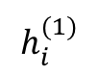
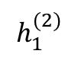
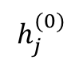
A glance of mini-batch training on graphs
A mini batch represents the computation graph for target nodes.
Small-world graphs lead to a huge computation graph.
2
3
$$h_{1}^{(2)}$$
1
1
10
5
$$h_{i}^{(1)}$$
2
3
4
5
6
9
4
6
8
7
$$h_{j}^{(0)}$$
1
3
4
6
7
8
9
10
11
11

Slide 24
Mini-batch with neighbor sampling
Prune the computation graph:
Sample neighbors from a neighbor list of a vertex.
1
1
2
3
4
5
6
2
4
1
7
8
1
3
4
6
7
8
9
10
11

Slide 25
Summary
The solution to many applications can be formulated as graph learning problems.
Graph neural networks are a new technique for graph learning.
They have multiple advantages over traditional methods.
It is an exciting area of research and they are increasingly find their way into production applications.

